Slide 1
CoinsCollector & CoinOp
Jay Luker
CS 250-SA, Spring ’08, Tufts

Slide 2
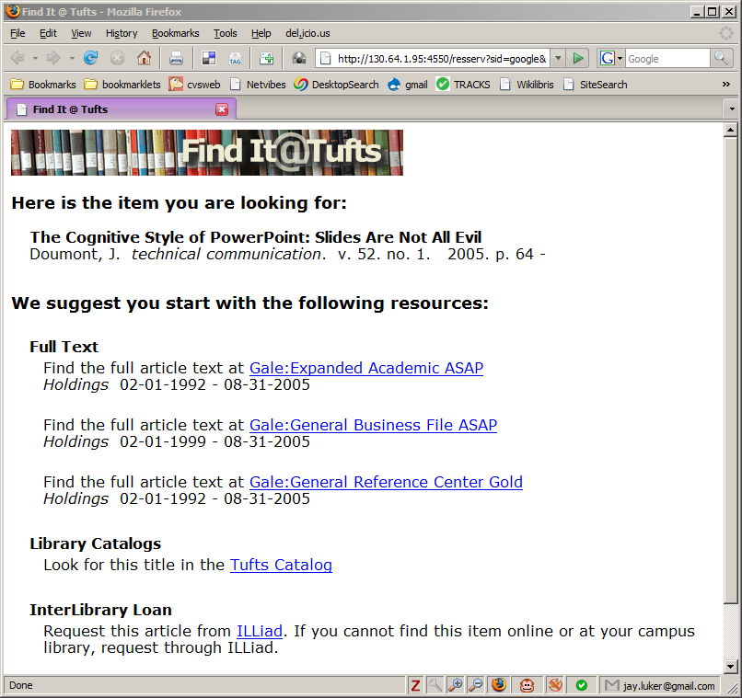
Let’s Review…
Link Resolver:
provides services based library holdings
OpenURL:
a link containing bibliographic metadata
COinS:
“latent” OpenURLs embedded in HTML
<span class=“Z3988” title=“ctx_ver=Z39.882004
&rft_val_fmt=info%3Aofi%2Ffmt%3Akev%3Amtx%3Ajournal
&rfr_id=info%3Asid%2Fdev.livingreviews.org%3AePubTk
&rft.aulast=Frolov&rft.volume=71&rft.date=2005
&rft.jtitle=Phys.+Rev.+D&rft.atitle=On+one+loop+
correction+to+energy+of+spinning+strings+in+S%285%29
&rft.genre=article&rft.pages=026006&rft.auinit=S.A”>
</span>
http://130.64.1.95:4550/resserv?ctx_ver=Z39.882004
&rft_val_fmt=info%3Aofi%2Ffmt%3Akev%3Amtx%3Ajournal
&rfr_id=info%3Asid%2Fdev.livingreviews.org%3AePubTk
&rft.aulast=Frolov&rft.volume=71&rft.date=2005
&rft.jtitle=Phys.+Rev.+D&rft.atitle=On+one+loop+
correction+to+energy+of+spinning+strings+in+S%285%29
&rft.genre=article&rft.pages=026006&rft.auinit=S.A
Notes:
for example, FindIt@Tufts
openurls are what you click on to get to a link resolver
Library environments need to provide reference links or extended service-links. Any old link wont do in most cases because it must be sensitive to the context of the user
COinS = Context Object in Span
Context Object is another name for the OpenURL metadata
COinS let you put openurls in HTML pages but let the client supply the appropriate resolver (Context Awareness)
Several browser extensions enable COinS -> link conversion, allow user to configure resolver URL

Slide 3
Problem #1
“Install This Thingy” doesn’t scale
Problem #2
Trying to collect usage logs from a bunch of link resolvers sucks
Notes:
#1 Getting users to install a browser extension is hard enough when they understand what the benefit is
#2 Link resolvers collect very interesting/valuable usage data about what people are researching, but…
#2 Potential for metadata loss at each stage of the harvesting: openurl -> log database -> harvesting format -> data warehouse
#2 Assuming you can even get access to the logs

Slide 4
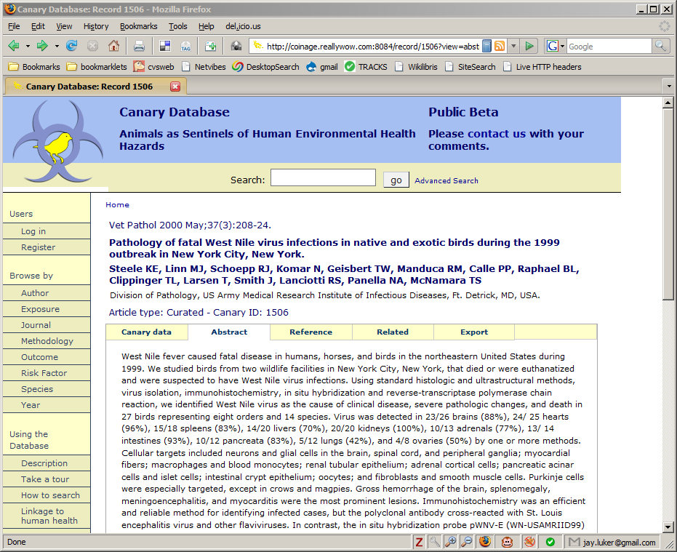
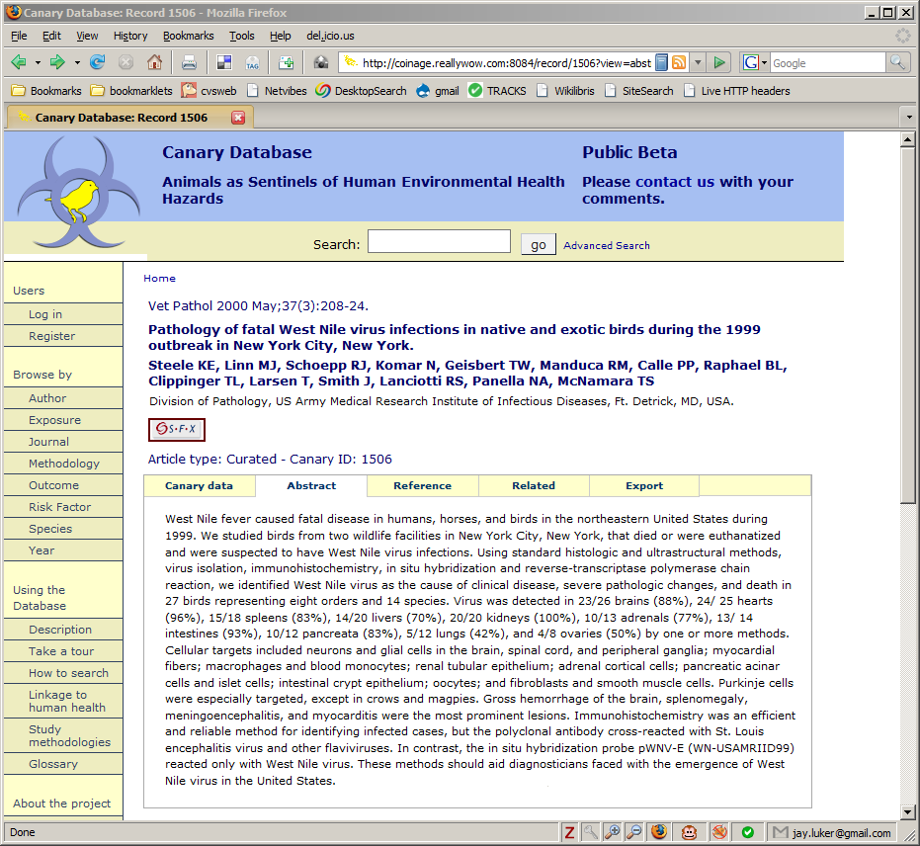
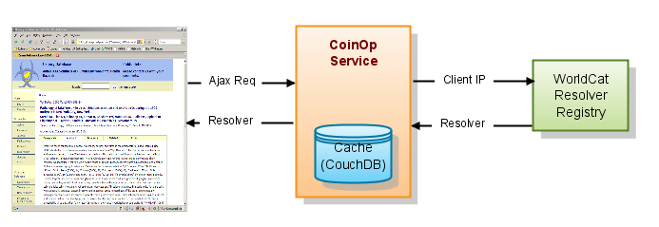
Solution #1: CoinOp
Allow for auto-discovery of COinS and the Link Resolver service component
<?xml version="1.0" encoding="UTF-8"?>
<resolverRegistryEntry>
<institutionName>TUFTS UNIV</institutionName>
<IPAddressRange>130.64.*.*</IPAddressRange>
<OCLCInstSymbol>TFW</OCLCInstSymbol>
<InstitutionID>1406</InstitutionID>
<resolver>
<resolverID>338260389</resolverID>
<source>FirstSearch</source>
<baseURL>http://library.tufts.edu:4550/resserv</baseURL>
<linkIcon>http://www.library.tufts.edu/finditattufts.gif</linkIcon>
<linkText> </linkText>
<OpenURLVersions>
<OpenURL_0.1/> <Z39.88-2004/>
</OpenURLVersions>
</resolver>
</resolverRegistryEntry>
…
<script type="text/javascript"
src="http://coinage.reallywow.com/coinop/engine?site=canary">
</script>
</body>
</html>
Notes:
auto-discovery removes the requirement for the client application to “know” it’s link resolver service address
site author embeds the javascript engine
engine sends request to the coinop service
coinop service queries resolver registry using client’s ip address
registry responds with any resolvers it finds
registry response is cached
resolver data sent back to the client
javascript engine updates the HTML document

Slide 5
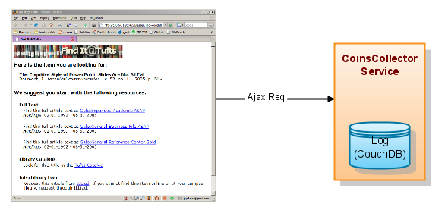
Solution #2: CoinsCollector
On-the-fly collection of research usage data
Notes:
works like google analytics
page author embeds javascript engine
javascript engine detects COinS and sends log request back to CoinsCollector service

Slide 6
Architectural Objectives
Context Awareness
  CoinOp turns COinS into OpenURLs based on the user’s context
Loose coupling / Late binding
  CoinOp allows for auto-discovery of the client’s link resolver
  CoinsCollector allows for a more loosely coupled usage data collection mechanism
Code on-demand
  Response data is in JSON format and specifies a javascript callback
Notes:
* IP address indicates user’s affiliation

Slide 7

Evaluation
Does it work? (quick demo)
Is it useful?
How well does it map to the principles and constraints of Resource-Oriented Architecture, a.k.a., REST?
  Sadly it’s not possible to do cross-domain AJAX without using HTTP GET (maybe w/ FF3 & IE8)
  All back-end interactions w/ CouchDB are RESTful
Notes:
Collector logging engine should be using PUT instead of GET

Slide 8
Future Directions
Other formats for embedded metadata, e.g., hCite, RDFa, unAPI
Something better than IP address for registry lookups: OpenID + FOAF?
What else could a service like CoinOp deliver?
  Recommendations (Conjure)
  Embedded Services

Slide 9



Dynamic Service Linking
NY Times
icanhascheezburger.com
TechCrunch
Wired
Notes:
Very commonly seen at news sites, blogs, etc.
“a list of the functions you can do from here, given the thing you're looking at now, depending on who you are”
How can we make these links context-sensitive?
using openurl-ish technology to improve dynamic service linking

